Slide 1


<Insert Picture Here>
23 Oracle Spatial 12.2 New Features

Slide 2
What’s new ?
1
Licensing and Packaging
Spatial Indexing
Location Tracking Service
GeoJSON
Location Data Enrichment
Web Services
GeoRaster
Network and Routing
2
3
4
5
6
7
8

Slide 3
What’s new ?
1
Licensing and Packaging
Spatial Indexing
Location Tracking Service
GeoJSON
Location Data Enrichment
Web Services
GeoRaster
Network and Routing
2
3
4
5
6
7
8

Slide 4
Map Visualization bundled with Oracle Spatial and Graph !
Includes
Mapping server (based on Oracle MapViewer)
HTML5 API
Map Builder
Packaged content for admin areas (countries, states, counties as JSON files)
OGC Services: WMS, WMTS
Deploy on any application server
On premise or in the Java Cloud Service

Slide 5
Pre-packaged GDAL
Linux and Windows only
Installed in $ORACLE_HOME/md/gdal
Need to setup your environment to use it
setenv GDAL_HOME ${ORACLE_HOME}/md/gdal
setenv GDAL_DATA ${GDAL_HOME}/data
setenv GDAL_DRIVER_PATH ${GDAL_HOME}/lib/gdalplugins
setenv PATH ${GDAL_HOME}/bin:${PATH}
setenv LD_LIBRARY_PATH ${GDAL_HOME}/lib:${LD_LIBRARY_PATH}

Slide 6
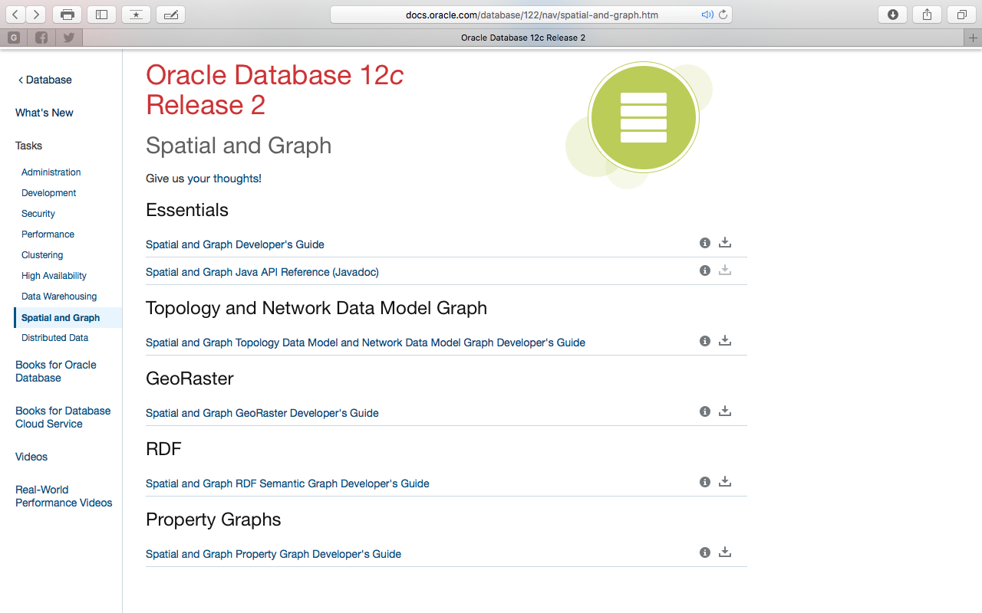
Reorganized Documentation

Slide 7
What’s new ?
1
Licensing and Packaging
Spatial Indexing
Location Tracking Service
GeoJSON
Location Data Enrichment
Web Services
GeoRaster
Network and Routing
2
3
4
5
6
7
8

Slide 8
Spatial Indexes are now OPTIONAL
In 12.1 and before a spatial index is required to do any spatial query:
Since 12.2, spatial indexes are optional
BUT: A spatial index is still required for moderate to large tables for achieving acceptable performance!
Not needed for very small tables (< 200 rows)
ORA-13226: interface not supported without a spatial index

Slide 9

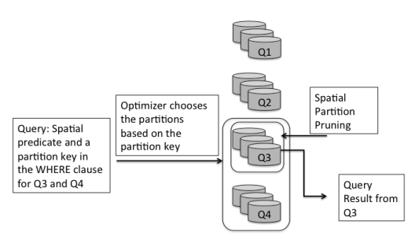
Use ANY Partitioning Method!
Support for all partitioning methods
Previously restricted to range partitioning
List partitioning, interval partitioning, hash partitioning, composite ...
Improved performance
Partition Pruning
Parallelism
Simplified Information Lifecycle Management

Slide 10
List Partitioning Example
Spatial table with data for each country
Partition the table so that each country is in its own partition
RANGE
LIST
create table road_segments (...)
partition by range (country_code)
(
partition p1 values less than ‘B’,
Partition p2 values less than ‘C’,
...
);
create table road_segments (...)
partition by list (country_code)
(
partition p1 values (‘AE’),
partition p2 values (‘AR’, ‘AS’),
partition p3 values (‘US’),
...
);

Slide 11
New Index Type: SPATIAL_INDEX_V2
Required for new partitioning methods (interval, list, hash, composite …)
Single partitioned RTREE for all partitions
Required for virtual column partitioning
Partitioning column is computed from other column(s)
Recommended for all tables
Will support future enhancements (sharding etc)
CREATE INDEX road_segments_idx on PT_CB(c2)
indextype is mdsys.spatial_index_v2
LOCAL;

Slide 12
New Index Structure: Optimized for Dynamic Point Data
R-tree index has performance bottlenecks when large numbers of concurrent DMLs are done on the spatial tables
Spatial index based on B-tree index
Internally create a composite b-tree index on (x,y)
Improves DML performance for large volumes of updates for point data
Queries are done using the same syntax, no application changes required
Requires SPATIAL_INDEX_V2
CREATE INDEX pt_idx on PT_CB(c2) indextype is mdsys.spatial_index_v2
PARAMETERS ('layer_gtype=POINT cbtree_index=true');

Slide 13
New Index Type Structure
Composite b-tree index on (x,y)
Implemented as a regular BTREE index called ﻿MDCT_nnnnn$:
Full flexibility for partitioning
Can create in parallel
Not allowed for SDO_JOIN operations
2D indexes only
CREATE INDEX "SCOTT"."MDCT_1252C$" ON "SCOTT"."US_CITIES" ("LOCATION"."SDO_POINT"."X", "LOCATION"."SDO_POINT"."Y")

Slide 14
Faster Index Creation
Test on ABI table: 10 million points
SQL> create index sidx on abi(geometry) indextype is mdsys.spatial_index_v2 parameters ('layer_gtype=POINT');
Index created.
Elapsed: 00:13:15.34
SQL> create index sidx on abi(geometry) indextype is mdsys.spatial_index_v2 parameters ('layer_gtype=POINT cbtree_index=true');
Index created.
Elapsed: 00:00:15.40

Slide 15
Faster Queries
select count(*) from abi, states
where sdo_filter(geometry, geom) = 'TRUE’;
Geodetic or Projected ? | R-Tree | Composite B-Tree
Projected | 00:00:57.51 | 00:00:16.12
Geodetic | 00:00:43.30 | 00:00:15.51
select count(*) from abi, counties
where sdo_filter(geometry, geom) = 'TRUE’;
Geodetic or Projected ? | R-Tree | Composite B-Tree
Projected | 00:01:09.81 | 00:01:06.77
Geodetic | 00:00:54.94 | 00:01:11.83

Slide 16
Performance Improvements
Improved index creation performance
Using Global Temporary Tables for intermediate steps
Reduced redo by a factor 3
2 to 3 times faster
Improved index statistics collection performance
Index Stats for 100 million rows
Redo: 772k (183,563,073 MBRs in 512 rows)
total collection elapsed time was 00:02:20.62 minutes

Slide 17
What’s new ?
1
Licensing and Packaging
Spatial Indexing
Location Tracking Service
GeoJSON
Location Data Enrichment
Web Services
GeoRaster
Network and Routing
2
3
4
5
6
7
8

Slide 18
Location Tracking APIs
Enhanced “point in polygon” analysis
Parallel polygon analysis for multiple moving objects and tracking regions
track millions of moving objects against thousands of regions
Designed for cloud based tracking services
PL/SQL API
Also Java API using JMX
Capture and track location-based events for very large volumes of moving objects
User created Tracking Regions
User Objects to be tracked
Location Messages Queue
Processing Queue
Process messages
Generate processing messages
Notification Queue
De-queue messages and send alerts
Notes:
Through a java application, customers can register regions that are used for tracking.
Then Java JMX queues are used to add location events that are tracked against these regions.
When the location event enters or leaves a specified region, alerts are generated.
Applications can then catch these alerts and generate other business processing events.

Slide 19
Location Tracking API workflow
Create regions of interest in database as polygon geometries
Initialize the location tracking server
Initialization of 3 queues: one for receiving location objects, one for receiving location messages, and one for storing the notifications after the locations are processed
Each location object (moving object) has many location messages
PL/SQL APIs to insert location objects and location messages
Retrieve alerts from the output queue and process as required
Java Applications: use AQ Java API to insert data into the input queues
JMX queues used for maximum performance

Slide 20
SDO_TRKR PL/SQL Package
Setup
CREATE_TRACKING_REGIONS: Define the tracking region(s)
START_TRACKING_REGIONS: Starts the queues for the location tracking server and starts jobs to monitor those queues.
SEND_TRACKING_MSG: Specify which object(s) to track against which region(s)
Process messages from tracked objects
SEND_LOCATION_MSGS: Send one or more location messages to the location server.
Process notifications
Monitor the <TR_REGION>_NOTIFICATION_Q queue for alerts that are generated from the tracking server for a given region

Slide 21
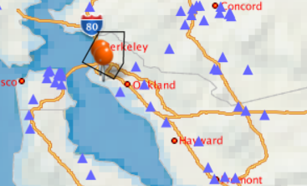
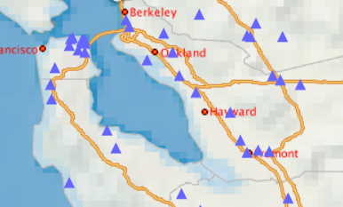
Location Tracking Examples
Two types of use cases
Track objects against a set of polygons and generate notifications when the moving objects enter the regions of interest
Track objects within a set of polygons and generate notifications when the moving objects leave the regions of interest

Slide 22

Tracking and Tracing – a few use cases
Logistics
Parcel delivery
Vehicle telematics
Insurance / Pay-as-you-drive
Smart Cities
Traffic monitoring
Public transport
Internet-of-Things
Asset tracking
Passenger / Customer movement
Technological concepts
Positional sensors
Streaming data
(x,y) coordinates, ie. point data
Choice of Oracle components
Oracle Stream Explorer
Oracle Big Data platform
Oracle Database
... depending on requirements such as volume, type of analysis, ...

Slide 23
What’s new ?
1
Licensing and Packaging
Spatial Indexing
Location Tracking Service
GeoJSON
Location Data Enrichment
Web Services
GeoRaster
Network and Routing
2
3
4
5
6
7
8

Slide 24

JSON Support in Oracle Database 12c
Store and manage JSON documents in Oracle Database
JSON stored as text (VARCHAR2 or CLOB)
Full text index (inverted index) on entire JSON documents
Functional indexes on specific attributes in JSON documents
Access JSON via developer-friendly APIs
REST services
Document-store API for Java (additional languages planned)
SQL query capabilities over JSON documents
Powerful reporting and analysis directly on JSON
Simple integration with relational data

Slide 25
Storing and Querying JSON
Application developers:
Store JSON using RESTful API
Analytical tools and business users:
Query JSON using SQL
PUT /my_database/my_schema/customers HTTP/1.0
Content-Type: application/json
Body:
{
"firstName": "John", “lastName”: "Smith", "age": 25, "address": { "streetAddress": "21 2nd Street", "city": "New York", "state": "NY", "postalCode": "10021“, "isBusiness" : false }, "phoneNumbers": [ {"type": "home", "number": "212 555-1234“ }, {"type": "fax", "number": "646 555-4567“ } ]
}
select
c.document.firstName,
c.document.lastName,
c.document.address.city
from customers c;”
firstName lastName address.city
----------- ----------- --------------
“John” “Smith” “New York”

Slide 26
GeoJSON: JSON for geometries
Extend JSON support in the database with Spatial operations
JSON_VALUE() supports GeoJSON and SDO_GEOMETRY
SDO_GEOMETRY constructors extended to take JSON as input
Support spatial index and spatial queries on JSON documents
Coordinates are in WGS84 (4326)
select json_value(
'{
"type": "Point",
"coordinates": [125.6, 10.1]
}', '$'
returning sdo_geometry
)
from dual;
SDO_GEOMETRY(2001, 4326, SDO_POINT_TYPE(125.6, 10.1, NULL), NULL, NULL)
Notes:
Spatial indexes can be created on JSON documents and all spatial operators are supported with JSON documents
containing spatial data.

Slide 27
GeoJSON Geometry Encoding
Type of geometry
Point, LineString, Polygon
MultiPoint, MultiLineString, MultiPolygon
Coordinates
Each point is an array that contains the X and Y values
Lines, polygons: multiple nested arrays of coordinates
{
"type": "Point",
"coordinates": [-73.943849, 40.6698]
}

Slide 28
Examples of GeoJSON Geometries
Point
Line
Polygon
{
"type": "Point",
"coordinates": [-73.943849, 40.6698]
}
{
"type": "Polygon",
"coordinates": [
[
[-105.032997, 39.129829],
...
[-105.032997, 39.129829]
]
]
}
{
"type": "LineString",
"coordinates": [
[-73.839157, 42.695122],
...
[-73.846558, 42.700333]
]
}

Slide 29
Examples of GeoJSON Geometries
Polygon with Hole
Multi Polygon
{
"type": "Polygon",
"coordinates": [
[
[-105.052597, 39.791199],
...
[-105.052597, 39.791199]
],
[
[-104.933578, 39.698139],
...
[-104.933578, 39.698139]
]
]
}
{
"type": "MultiPolygon",
"coordinates": [
[
[
[-104.884201, 39.7402], ...
[-104.884201, 39.7402]
]
],
[
[
[-104.933578, 39.698139], ...
[-104.933578,39.698139]
]
]
]
}
Outer Ring
First Polygon
InnerRing
SecondPolygon

Slide 30
GeoJSON Feature: Geometry with Properties
{
"type": "Feature",
"properties": {
"CITY": "Jersey City",
"STATE_ABRV": "NJ",
"POP90": 228537.0,
"RANK90": 67.0
},
"geometry": {
"type": "Point",
"coordinates": [ -74.064962, 40.7113 ]
}
}
A type: “Feature”
A collection of properties
A geometry

Slide 31
GeoJSON Feature Collection: A Collection of Features
{
"type": "FeatureCollection",
"features": [
{ "type": "Feature", "properties": { ... }, "geometry": {...} },
...
{ "type": "Feature", "properties": { ... }, "geometry": {...} }
]
}

Slide 32
SDO_GEOMETRY or GeoJSON?
Determined by application design
Applications requiring a JSON document store, can keep geometry attributes stored as GeoJSON inside the JSON documents
Can mix JSON and spatial predicates in same query
Conversion between JSON and SDO_GEOMETRY
SDO_UTIL.From_GeoJSON() and To_GeoJSON functions
SDO_GEOMETRY Get_GeoJSON() method
Integrate third party applications that expect SDO_GEOMETRY by
Defining a function-based index on JSON returning SDO_GEOMETRY

Slide 33
Generating GeoJSON Geometries
Using the SDO_GEOMETRY method GET_GEOJSON()
Remember to use a table alias !
Using the SDO_UTIL.TO_GEOJSON() function
select id, c.location.get_geojson() as json from us_cities c;
select id, sdo_util.to_geojson(location) as json from us_cities;
ID JSON
----- ------------------------------------------------------------
1 { "type": "Point", "coordinates": [-73.943849, 40.6698] }
2 { "type": "Point", "coordinates": [-118.411201, 34.112101] }
...
195 { "type": "Point", "coordinates": [-118.751299, 34.26305] }
195 rows selected.

Slide 34
Generating GeoJSON Features
select json_object(
'type' value 'Feature',
'properties' value json_object (
'CITY' value city,
'STATE_ABRV' value state_abrv,
'POP90' value pop90,
'RANK90' value rank90
),
'geometry' value c.location.get_geojson() format json
)
from us_cities c;
{"type":"Feature", "properties":{"CITY":"New York", "STATE_ABRV":"NY", "POP90":7322564, "RANK90":1}, "geometry":{ "type": "Point", "coordinates": [-73.943849, 40.6698] }}

Slide 35
Generating GeoJSON Features: Known Issues in 12.2.0.1
select replace (
to_clob (
json_object(
'type' value 'Feature',
'properties' value json_object (
'CITY' value city,
'STATE_ABRV' value state_abrv,
'POP90' value pop90,
'RANK90' value rank90
),
'geometry' value '###########'
)
),
'"###########"', c.location.get_geojson()
) as json
from us_cities c;
JSON functions only handle VARCHAR2
JSON strings in CLOB not interpreted as JSON
Use dummy string and replace with JSON string
Cast result to CLOB before replacing

Slide 36
Generating GeoJSON Feature Collection
select json_object (
'type' value 'FeatureCollection',
'features' value
json_arrayagg(
json_object(
'type' value 'Feature',
'properties' value json_object (
'CITY' value city,
'STATE_ABRV' value state_abrv,
'POP90' value pop90,
'RANK90' value rank90
),
'geometry' value c.location.get_geojson() format json
)
)
)
from us_cities c;
NOTE
This does not work in 12.2.0.1 due to the limits in the JSON processing functions to process CLOBs

Slide 37
Setup for GeoJSON Examples …
Add columns to the US_CITIES table
LOCATION_G = GeoJSON Geometries
LOCATION_F = GeoJSON Features
alter table us_cities
add location_g clob check (location_g is json)
add location_f clob check (location_f is json);
{ "type": "Point", "coordinates": [-73.943849, 40.6698] }
{"type":"Feature","properties":{"CITY":"New York", "STATE_ABRV":"NY","POP90":7322564,"RANK90":1}, "geometry":{ "type": "Point", "coordinates": [-73.943849, 40.6698] }}

Slide 38
Reading GeoJSON Geometries
Using the SDO_UTIL.FROM_GEOJSON() function
No SRID specified: will use 4326
With an explicit SRID
Using the JSON_VALUE() function
Note that this does not let you choose a SRID.
select id, sdo_util.from_geojson(location_g) from us_cities;
select id, sdo_util.from_geojson(location_g,null,8307) from us_cities;
select id, json_value(location_g, '$' returning sdo_geometry)
from us_cities;

Slide 39
Reading GeoJSON Features
Use the dot notation to extract info from a JSON document
Get all properties in JSON
Get selected properties
select c.location_f.properties from us_cities c;
{"CITY":"Simi Valley","STATE_ABRV":"CA","POP90":100217,"RANK90":195}
...
select c.location_f.properties.CITY, c.location_f.properties.STATE_ABRV
from us_cities c;
Simi Valley CA
...

Slide 40
Reading GeoJSON Features
Use JSON_VALUE to extract the geometry
Use SDO_UTIL.FROM_GEOJSON() with dot notation
select id, json_value(location_f, '$.geometry' returning sdo_geometry)
from us_cities;
select id, json_value(c.location_f.geometry, '$' returning sdo_geometry)
from us_cities c;
select id, sdo_util.from_geojson(c.location_f.geometry)
from us_cities c;

Slide 41
Reading GeoJSON Feature Collection
Use JSON_TABLE to split the collection in individual features
select f.id, f.city, f.state_abrv, f.pop90, f.rank90,
sdo_util.from_geojson(location) location
from json_documents d,
json_table(
json_document,'$.features[*]'
columns (
id for ordinality,
city varchar2(40) path '$.properties.CITY',
state_abrv varchar2(2) path '$.properties.STATE_ABRV',
pop90 number path '$.properties.POP90',
rank90 number path '$.properties.RANK90',
location format json path '$.geometry’
)
) f;
Name Null? Type
------------------- -------- ------
ID NOT NULL NUMBER
JSON_DOCUMENT CLOB

Slide 42
Indexing GeoJSON Geometries
Setup spatial metadata
The index
insert into user_sdo_geom_metadata values (
'US_CITIES', 'JSON_VALUE(location_g, ''$'' returning sdo_geometry)',
sdo_dim_array (
sdo_dim_element ('Long',-180,180,0.05),
sdo_dim_element ('Lat',-90,90,0.05)
),
4326
);
create index us_cities_sx_g
on us_cities (JSON_VALUE(location_g, '$' returning sdo_geometry))
indextype is mdsys.spatial_index_v2;

Slide 43
Indexing GeoJSON Features
Setup spatial metadata
The index
insert into user_sdo_geom_metadata values (
'US_CITIES', 'JSON_VALUE(location_f, ''$.geometry'' returning sdo_geometry)',
sdo_dim_array (
sdo_dim_element ('Long',-180,180,0.05),
sdo_dim_element ('Lat',-90,90,0.05)
),
4326
);
create index us_cities_sx_f
on us_cities (JSON_VALUE(location_f, '$.geometry' returning sdo_geometry))
indextype is mdsys.spatial_index_v2;

Slide 44
Querying GeoJSON Geometries
select count(*)
from us_cities c, us_interstates i
where sdo_within_distance (
JSON_VALUE(location_g, '$' returning sdo_geometry),
i.geom,
'distance=150 unit=km'
) = 'TRUE'
and i.interstate='I95';
select count(*)
from us_cities c, us_interstates i
where sdo_within_distance (
i.geom,
JSON_VALUE(location_g, '$' returning sdo_geometry),
'distance=150 unit=km'
) = 'TRUE'
and c.city='Chicago';

Slide 45
Querying GeoJSON Features
select count(*)
from us_cities c, us_interstates i
where sdo_within_distance (
JSON_VALUE(location_f, '$.geometry' returning sdo_geometry),
i.geom,
'distance=150 unit=km'
) = 'TRUE'
and i.interstate='I95';
select count(*)
from us_cities c, us_interstates i
where sdo_within_distance (
i.geom,
JSON_VALUE(location_f, '$.geometry' returning sdo_geometry),
'distance=150 unit=km'
) = 'TRUE'
and c.city='Chicago';

Slide 46
Summary of GeoJSON operations …
CREATE TABLE us_cities (
id NUMBER,
city VARCHAR2(42),
state_abrv CHAR(2),
location VARCHAR2(4000)
CONSTRAINT json_check CHECK (location IS JSON)
);
INSERT INTO us_cities (id, city, state_abrv, location)
VALUES (1,'New York’,'NY’,'{"type":"Point","coordinates":[-73.943849, 40.6698]}’);
CREATE INDEX us_cities_sx
on us_cities (JSON_VALUE(location, '$' RETURNING SDO_GEOMETRY)
INDEXTYPE IS MDSYS.SPATIAL_INDEX;
SELECT id, JSON_VALUE(location, '$' RETURNING SDO_GEOMETRY)
FROM us_cities where id=1;

Slide 47
What’s new ?
1
Licensing and Packaging
Spatial Indexing
Location Tracking Service
GeoJSON
Location Data Enrichment
Web Services
GeoRaster
Network and Routing
2
3
4
5
6
7
8

Slide 48

Data Enrichment API
Search API to match full or partial place names within a hierarchy
Text Index based place name search for hierarchies
Example 1: “nashua, nh, usa”, “nashua, new hampshire, USA” match to the same record
Example 2: “San Fran, CA”, “Location:San Fransico, California”, “Location: 圣，美国加利福尼亚州” all result in SAN FRANCISCO:CALIFORNIA:USA:ENG: -122.4204 37.775592
Used for data categorization when large number of records with location tags are collected for analysis
Hierarchical names data set
Contains administrative area names for most of the countries in the world
Not part of the geocoder, but a standalone API with bundled data
Based on Geonames.org dataset

Slide 49
Use Cases For Data enrichment API
Call data records, logs from applications, social network posts …
Logs can contain references to place names: partial, full or multilingual
Match all of these references to the same standard text key
San Fran, CA,…
San Francisco, California,…
圣francisco ，美国加利福尼亚州
SAN FRANCISCO:SAN FRANCISCO:CALIFORNIA:UNITED STATES -122.4204 37.775592

Slide 50
Setup: Prepare the GeoNames dataset
Provided in $ORACLE_HOME/md/demo/GeoSearch
Data provided as a split archive (files X00, X01, …)
First concatenate the files …
Then unzip the archive …
Prepare for importing
$ cat $ORACLE_HOME/md/demo/GeoSearch/x* > /tmp/eloc_admin_area_search.zip
$ unzip /tmp/eloc_admin_area_search.zip –d /tmp
SQL> create directory tmp_dir as '/tmp';

Slide 51
Setup: Import the GeoNames dataset
Create the catalog table
Import the table
CREATE TABLE ELOC_ADMIN_AREA_SEARCH (
FULL_NAME VARCHAR2(4000 CHAR),
AREA_NAME VARCHAR2(64 CHAR),
KEY VARCHAR2(4000 CHAR),
LANG_CODE VARCHAR2(3),
CENTER_LONG NUMBER,
CENTER_LAT NUMBER,
POPULATION NUMBER,
PART_ID NUMBER
);
$ impdp system/oracle directory=tmp_dir dumpfile=ELOC_ADMIN_AREA_SEARCH.DMP remap_schema=herman:scott table_exists_action=append exclude=index

Slide 52
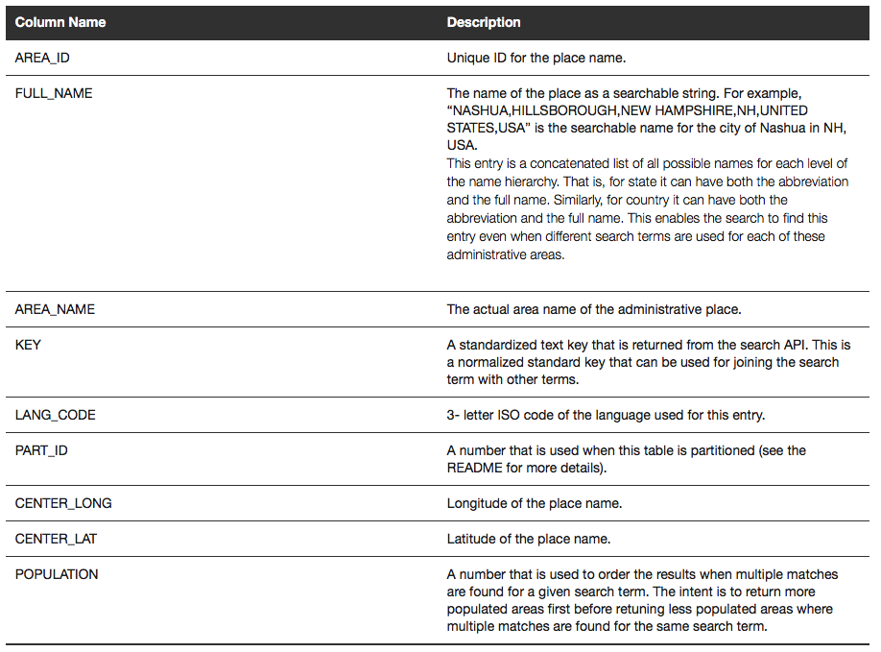
The ELOC_ADMIN_AREA_SEARCH table

Slide 53
Index the GeoNames Dataset
Setup index parameters
Create the text index
exec ctx_ddl.create_preference('eloclex', 'WORLD_LEXER')
exec ctx_ddl.create_section_group('elocsec', 'BASIC_SECTION_GROUP')
exec ctx_ddl.create_preference('elocds', 'MULTI_COLUMN_DATASTORE')
exec ctx_ddl.set_attribute('elocds', 'COLUMNS', '''XSTARTX ''||full_name||'' XENDX''')
exec ctx_ddl.set_attribute('elocds', 'DELIMITER', 'NEWLINE')
create index eloc_index2 on ELOC_ADMIN_AREA_SEARCH(FULL_NAME)
indextype is ctxsys.context
order by population
parameters (
'sync (on commit) lexer eloclex datastore elocds section group elocsec memory 400m’
);

Slide 54
Examples of Use: SDO_UTIL.GEO_SEARCH() function
select * from table(sdo_util.geo_search('san francisco, ca, UNITED STATES'));
SAN FRANCISCO|SAN FRANCISCO|CALIFORNIA|UNITED STATES ENG -122.4204 37.775592
SOUTH SAN FRANSISCO|SAN FRANCISCO|CALIFORNIA|UNITED STATES ENG -122.4204 37.775592
SAN FRANCISCO|CALIFORNIA|UNITED STATES ENG -122.4204 37.775592
select * from table(sdo_util.geo_search('san frasisco, california, USA'));
SAN FRANSISCO|SAN FRANCISCO|CALIFORNIA|UNITED STATES ENG -122.4204 37.775592

Slide 55
Extensible Reference Dataset
Define a new location
insert into ELOC_ADMIN_AREA_SEARCH (
area_id,full_name,area_name,key,lang_code,part_id,center_lon, center_lat, population
)
values (
1469286010,
'CENTRAL PARK,NEW YORK CITY,NEW YORK,NYC,RICHMOND,NEW YORK,NY,UNITED STATES,USA',
'CENTRAL PARK',
'CENTRAL PARK|NEW YORK|RICHMOND|NEW YORK|UNITED STATES',
'ENG',
7,
73.9654,40.7829, 0
);
select * from table(sdo_util.geo_search('central park'));

Slide 56
What’s new ?
1
Licensing and Packaging
Spatial Indexing
Location Tracking Service
GeoJSON
Location Data Enrichment
Web Services
GeoRaster
Network and Routing
2
3
4
5
6
7
8

Slide 57

Web Services Enhancements
New: Web Coverage Service (WCS)
Redesigned: Catalog Services for the Web (CSW)
Enhanced: Web Feature Service (WFS)
New: Spatial Web Services Administration Console for WFS, WCS, and CSW
Unified WFS, WCS, and CSW Framework and Architecture
Unified configuration, logging, administration, …
Simplified URLs for access:
http://<server>:<port>/oraclespatial/<service>
<service> = wcs, wfs, csw

Slide 58
Web Coverage Service (WCS)
WCS 2.0.1
Publish Georaster data
KVP, POST and SOAP protocols
GeoTiff Coverage Encoding extension
CRS extension
Range Subset extension (Request specific layers)
Scaling extension
Interpolation extension
Publish data in any format (via GDAL)

Slide 59
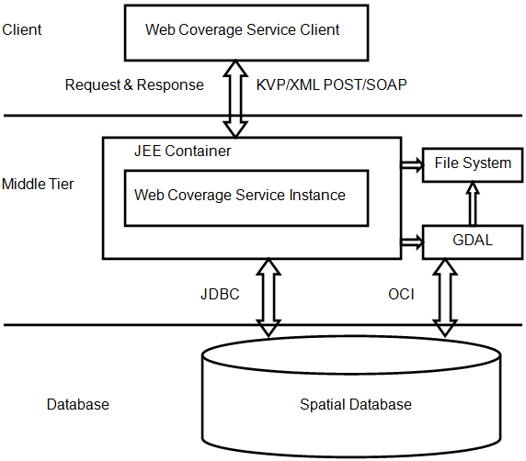
WCS Architecture
WCS Requests:
GetCapabilities
DescribeCoverage
GetCoverage
SDO_WCS package:
Publish
Unpublish
Manage privileges

Slide 60
Catalog Services for the Web (CSW)
CSW 2.0.2
New implementation, fully redesigned
Based on XML binary storage
Supports DCMI (Dublin Core), Inspire, ISO profiles
KVP, POST and SOAP protocols
Loader for populating the catalog
Package SDO_CSW for administration

Slide 61
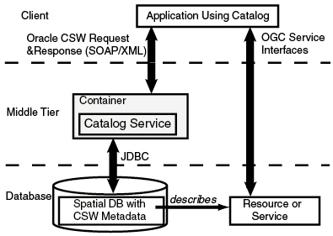
CSW Architecture
CSWRequests:
GetCapabilities
DescribeRecord
GetRecords
GetRecordById
SDO_CSW package:
Manage indexing
Spatial and XPath

Slide 62
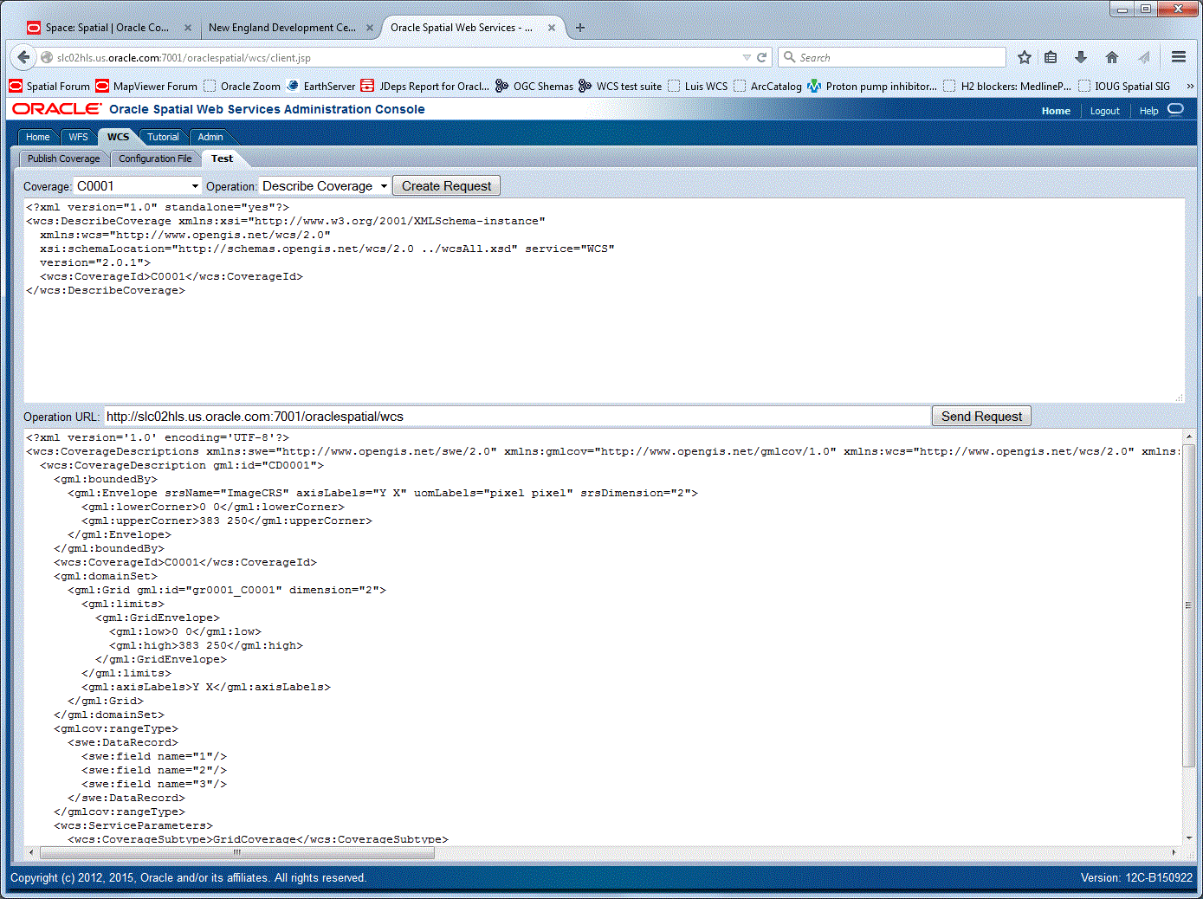
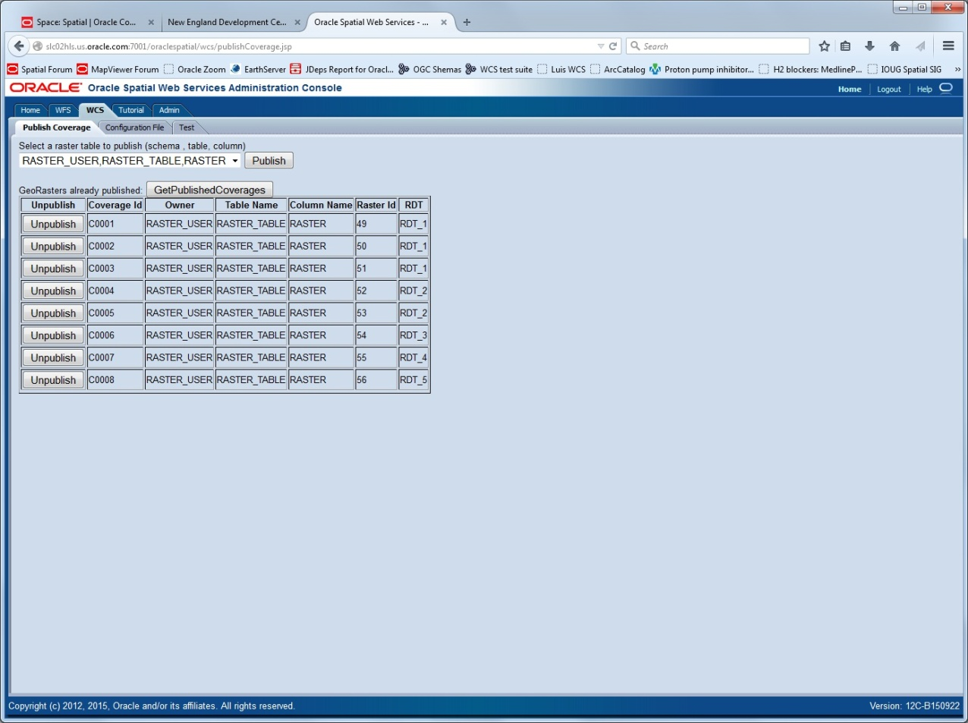

Slide 64
What’s new ?
1
Licensing and Packaging
Spatial Indexing
Location Tracking Service
GeoJSON
Location Data Enrichment
Web Services
GeoRaster
Network and Routing
2
3
4
5
6
7
8

Slide 65


Native JPEG 2000 Compression!

Slide 66
Native JPEG 2000 Compression!
The same as JP2 file. Stored in a single BLOB. Image can be tiled
High compression ratio. For the same quality, 2-7 times smaller than JPEG image
Support both lossless and lossy compressions
No separate pyramids. Pyramid level is limited by tile dimension sizes
Support 8bit and 16bit integer images
No limit on number of bands
Support very large size image. Size is limited by memory and max number of tiles (max_mem_size / 20 * 65535)

Slide 67
Using JP2-compressed Rasters
New procedures:
sdo_geor.compressJP2()
sdo_geor.decompressJP2()
All key functions read JP2-compressed images:
getRasterSubset, subset, rectify, large scale mosaicking, virtual mosaic, and raster algebra.
Most functions, such as getRasterSubset, subset, and virtual mosaic support partial decompressing (faster).
A few require full image decompressing (slower).

Slide 68
Importing JP2 rasters
Direct loading with GDAL without decompression and recompression!
Content of input loaded as-is into the raster table
Complete with pyramid!
gdal_translate -of georaster /images/image_3.jp2 \
georaster:georaster/georaster@my_db,image_table,raster \
-co "insert=(id,label,raster) values (3, 'image_3', sdo_geor.init('rdt_table', 3)" \
-co compress=jp2-f

Slide 69
New Image Processing: Package SDO_GEOR_IP
Linear stretching
Piecewise stretching
Equalization
Normalization
Histogram matching
Dodging
Filtering
Warping
Affine transformation

Slide 70
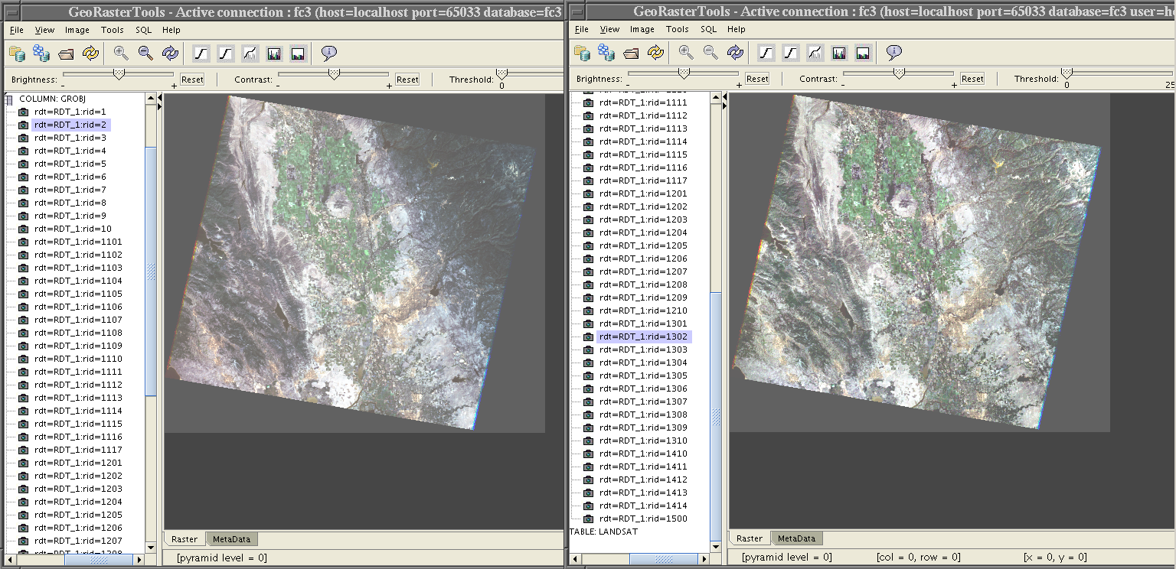
Example – Image Dodging
This dodging operation uses an adaptive image enhancement method to make the image tone more balanced, that is, the darker area becomes brighter and the bright area becomes darker.

Slide 71
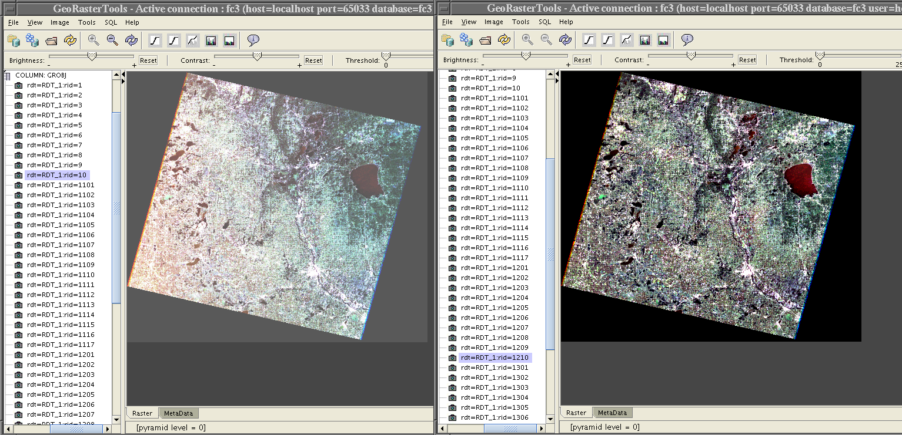
Example – Image Dodging

Slide 72
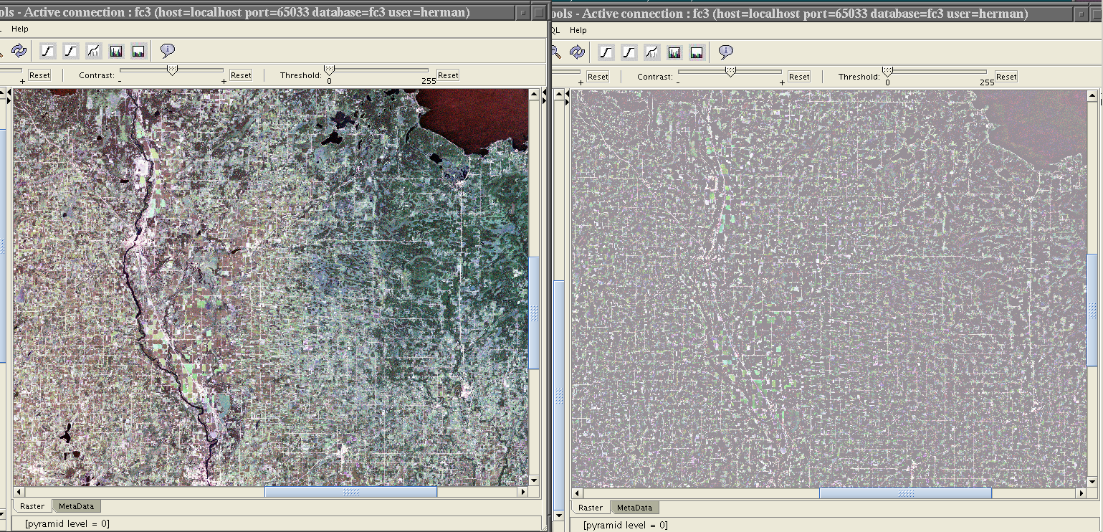
Example – High Pass Filtering
Applying a high-pass filter on an image can enhance the details of the image or even detect the edges inside the image.

Slide 73
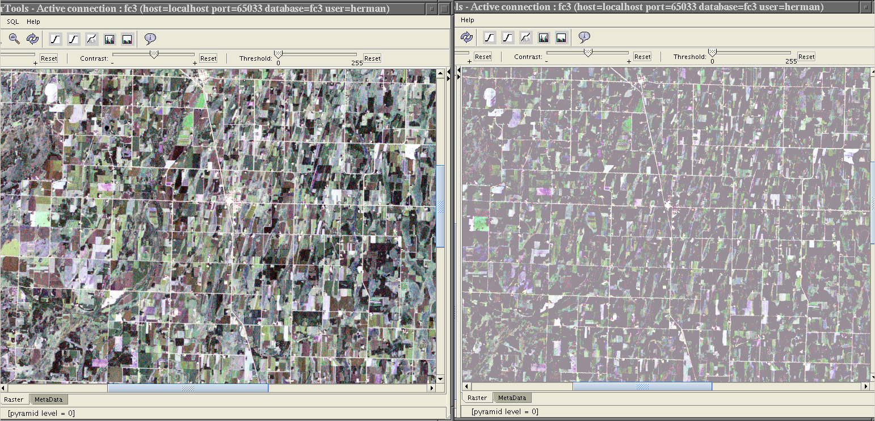
Example – High Pass Filtering

Slide 74
Color Balancing Methods for Mosaicking
Linear Stretching
(1) to the given min and max value or (2) to the given reference image band by band
Statistic Matching (Normalization)
(1) to the given mean and std value or
(2) to the given reference image band by band or
(3) to use overlapping areas image by image and band by band
Histogram Matching
(1) to the given histogram or
(2) to the given reference image band by band or
(3) to use overlapping areas image by image and band by band

Slide 75
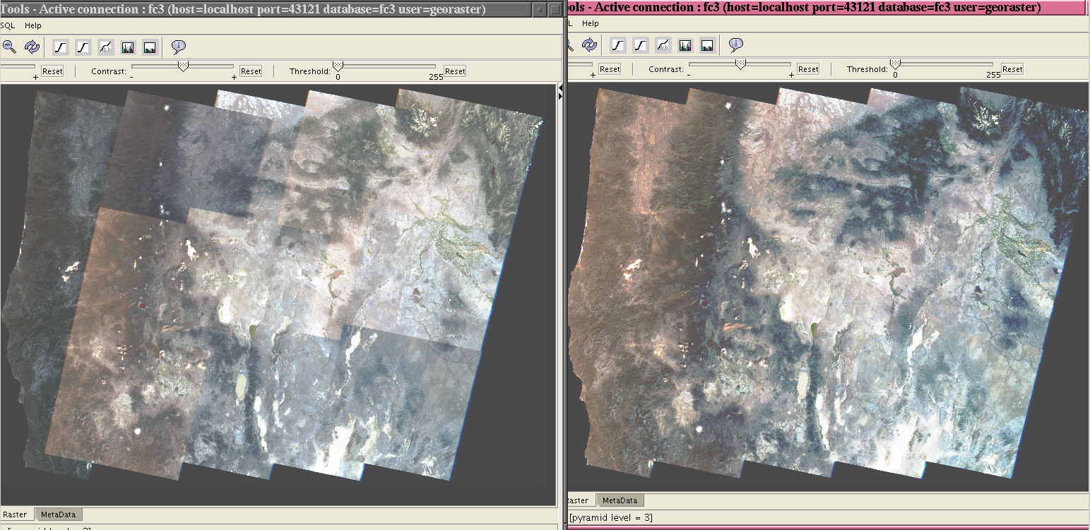
Example – Image Mosaic with Statistic Matching

Slide 76
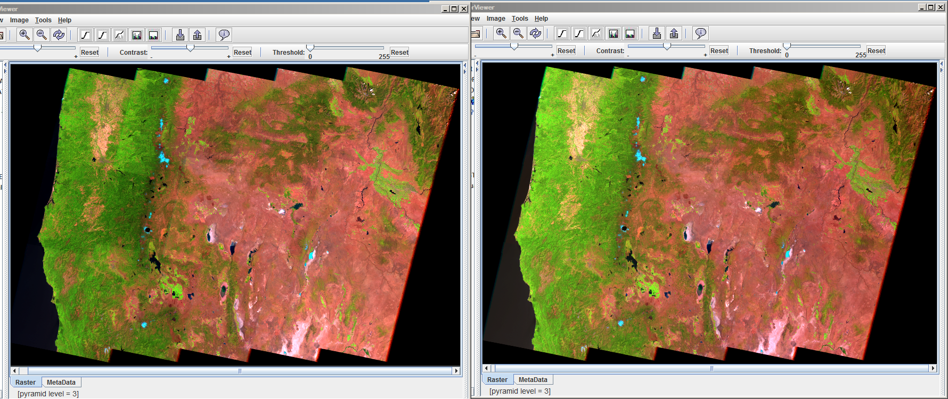
Example – Image Mosaic with Statistic Matching

Slide 77
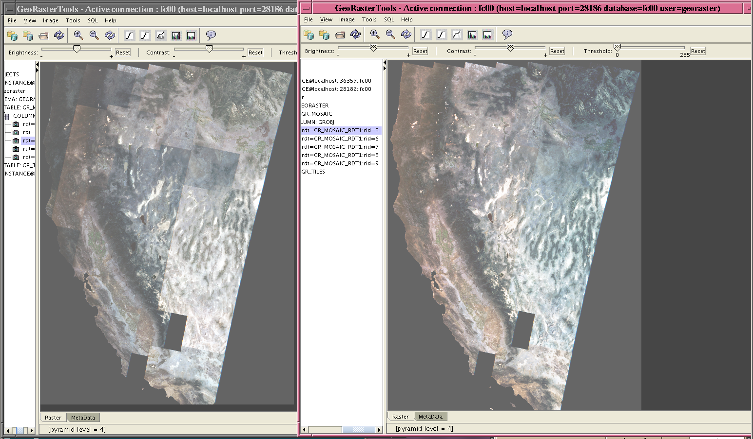
Example – Image Mosaic with Statistic Matching

Slide 78
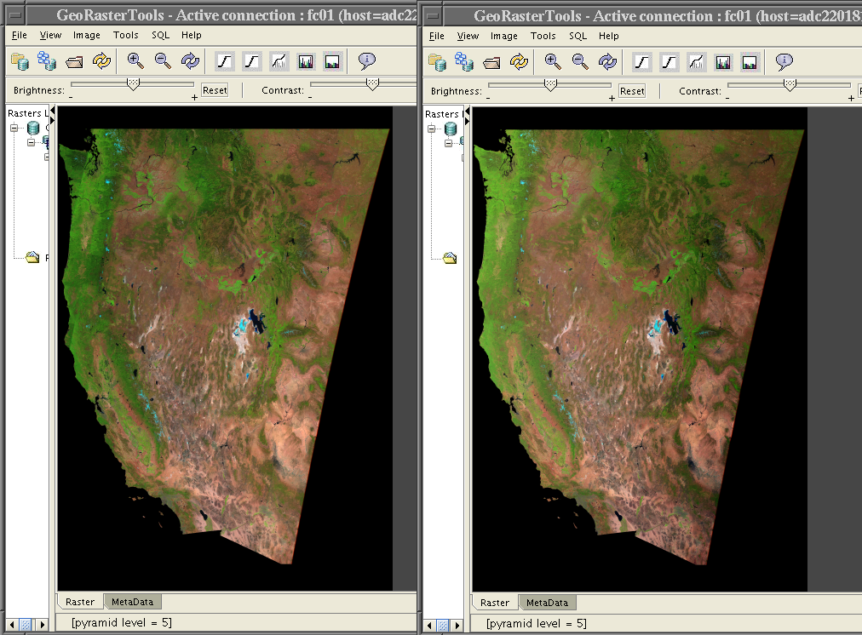
Example – Image Mosaic with Statistic Matching

Slide 79
Raster Algebra
26 New Operators added to the Raster Algebra language
conditionalExpr (same as if … then … else …)
^ (i.e., XOR), % (i.e., MODULO), POWER, FACTORIAL
Local statistic operators
many others
3 New Overlay Functions
DIFF
OVER
STACK

Slide 80
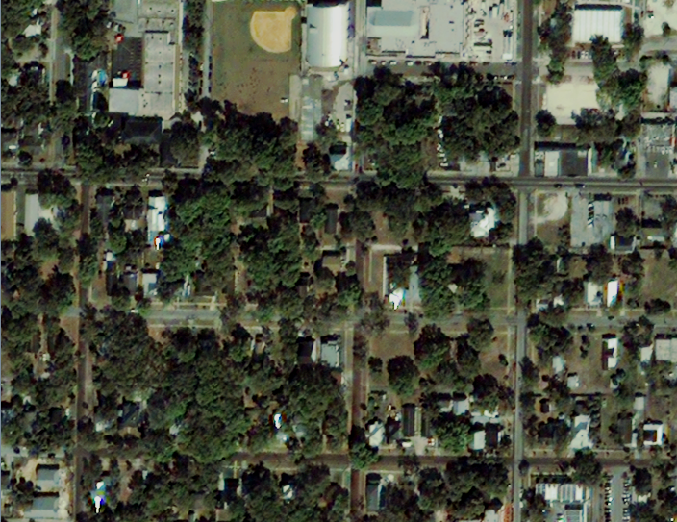
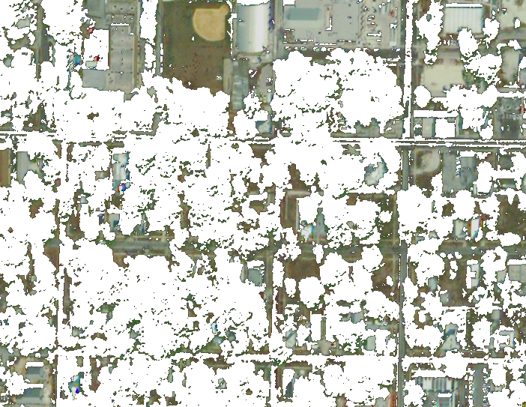
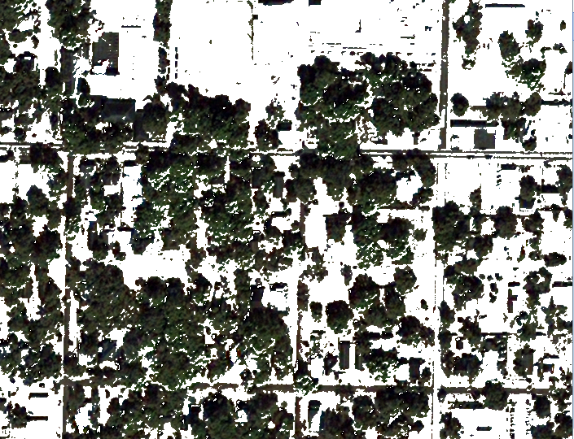
Example – DIFF Operation
DIFF
Original Image
Tree-removed Image
Tree-only Image

Slide 81
Raster Algebra
Can use any number of GeoRaster objects in Raster Algebra
Was limited to 8 raster objects
Support sub-cell statistic mean (average) analysis
Area weighted average based on intersection of irregular query boundary with cells
For DEM, precision farming, climate modeling, low-resolution image analysis etc.
Parallelized all statistic generation functions
min, max, mean, median, mode, std

Slide 82
Core Georaster Functions (SDO_GEOR)
New functions for cell-level access
getCellValues, evaluateDoubles, changeCellvalues, getBitmapMaskValues
Allow multiple points access in one function call
getRasterSubset can return cell values in array directly
Simplify development and improve query performance

Slide 83
Core Georaster Functions (SDO_GEOR)
DEM based 3D surface area computation with parallelism (using 3D triangles)
generateBitmapPyramid (needed to run provided scripts)
Area weighted sub-cell statistic average/mean analysis
Color ramping functions to automatically generate colormaps for grids or images
Raster warping function

Slide 84
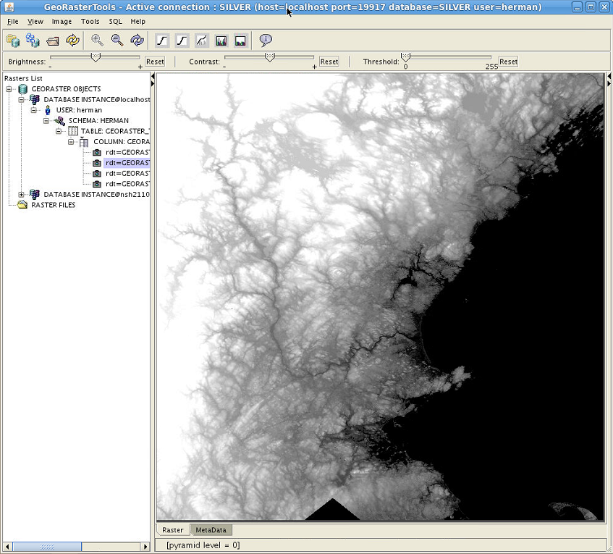
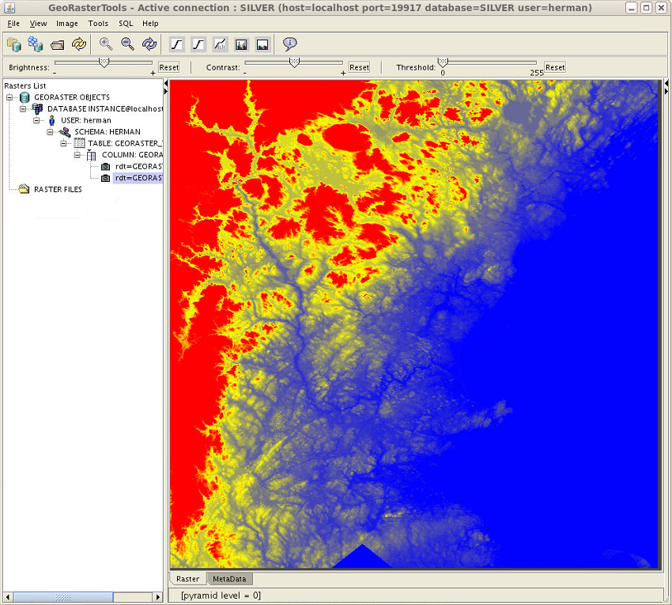
Example – Color Ramping

Slide 85
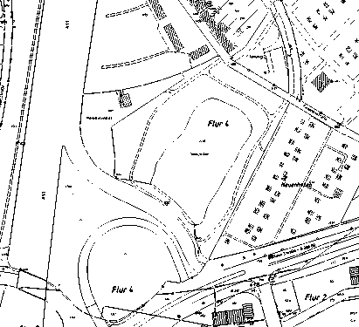
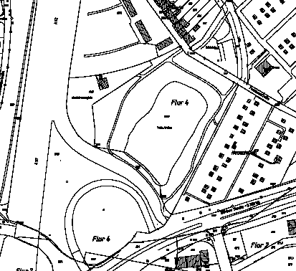
Example – generateBitmapPyramid
Old Pyramid
(with missing and dash lines)
New Pyramid
(no dash lines)
(Map Data Courtesy of G.ON)

Slide 86
Core Georaster Functions Performance
Memory control functions
Enable users to control how much memory to use
Allows bigger memory usage
Improve performance of all GeoRaster operations by limiting I/O overhead.
More parallelism
Rectification, compression, statistics generation
Internal “sysdata” caching
Improves performance of repeated calls of simple access functions on same raster
Example: repeated calls of getCellValue and changeCellValue by about 30%.

Slide 87
Java API
New Virtual Mosaic API
Speeds up integration
Used by MapViewer
New Virtual Mosaic theme

Slide 88
Viewer and ETL
Single integrated tool
ETL and Viewer
Virtual Mosaic display is significantly enhanced
New GUI to automate some SQL tasks:
Creating GeoRaster tables
Generating pyramids
Rectifying images
…

Slide 89
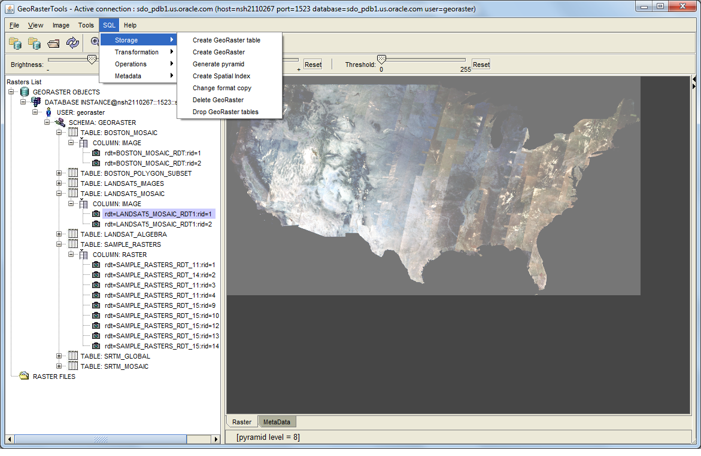

Slide 90
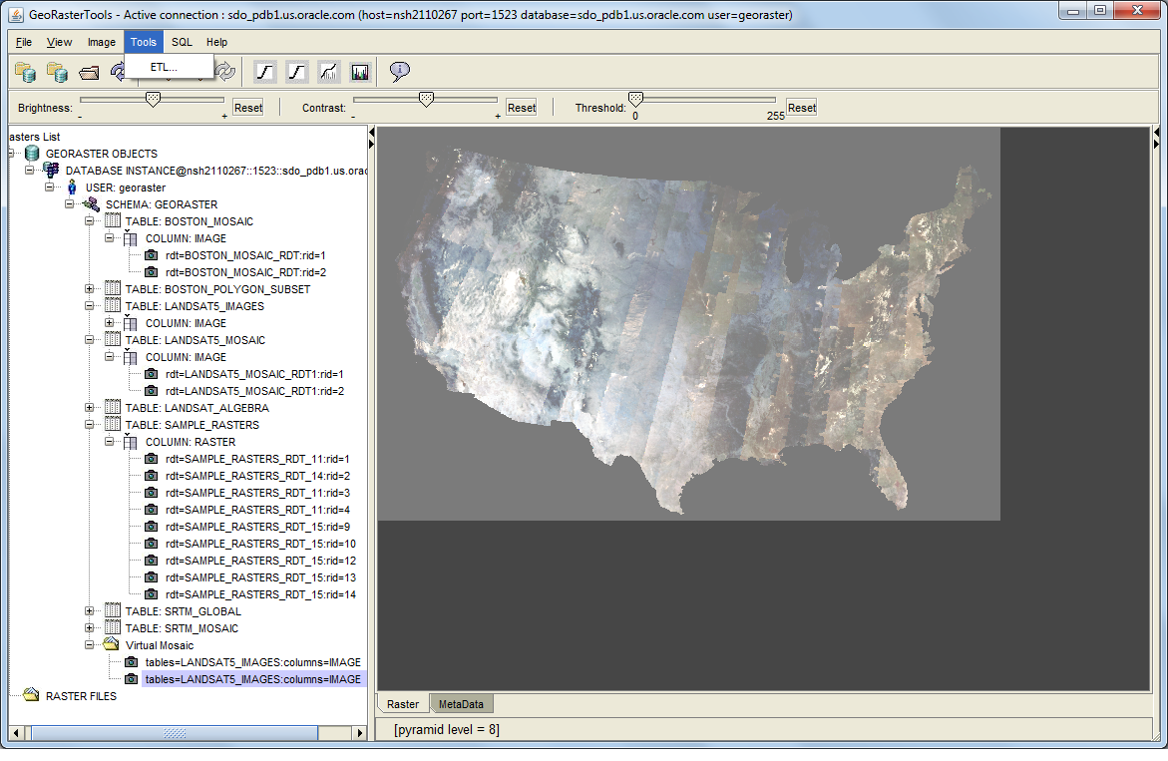

Slide 91
What’s new ?
1
Licensing and Packaging
Spatial Indexing
Location Tracking Service
GeoJSON
Location Data Enrichment
Web Services
GeoRaster
Network and Routing
2
3
4
5
6
7
8

Slide 92
Network Data Model Enhancements
Multiple TSPs/Single Depot
Network Buffers
Randomized TSP solution
Feature model editor
Parallel Framework for Independent Analysis Tasks

Slide 93
Multiple TSPs/Single Depot – Vehicle Routing Problem
A solution for multiple sale persons (vehicles)
Assign each sales person to a group of customers, find the TSP route for each group to minimize total route cost
Cluster-first, route-second approach
Clustering Approaches
K Means
Bisection Partition
User defined Partition approaches
TSP route computation
Can specify a depot for single depot VRP

Slide 94
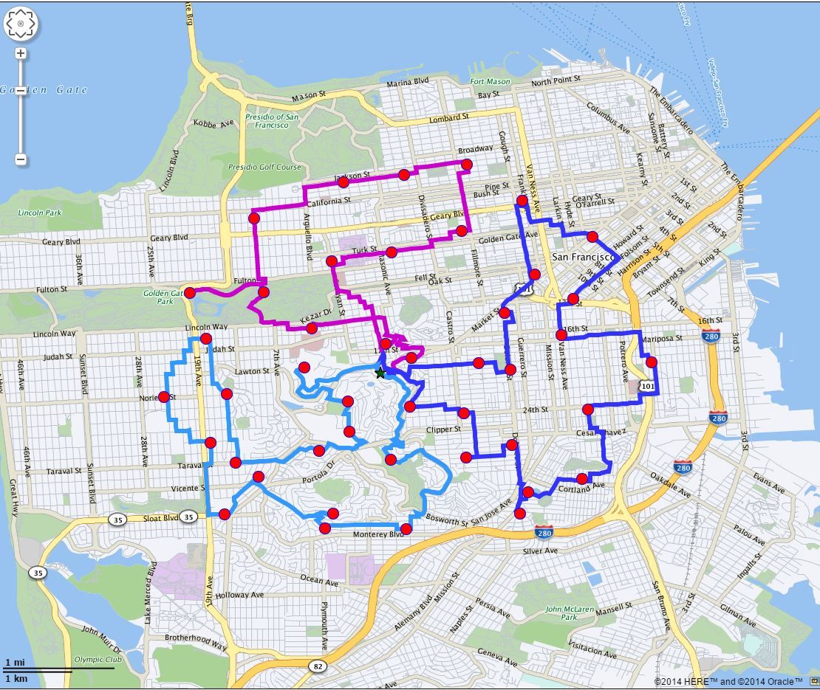
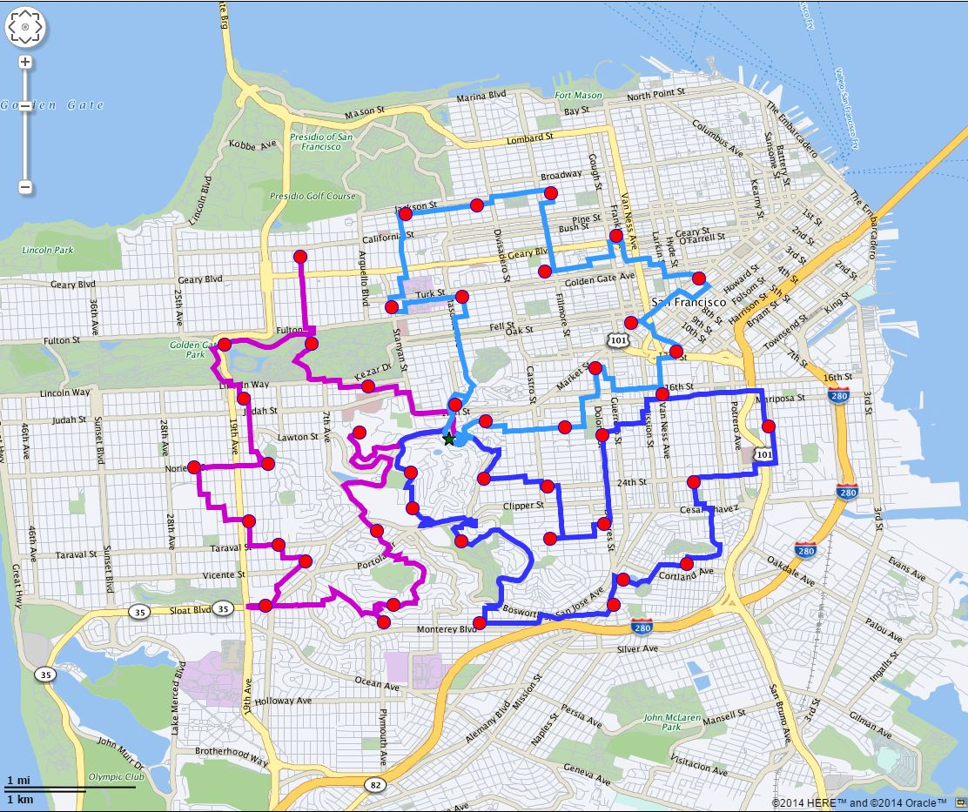
Clustering/Multiple TSPs Examples

Slide 95
Time Support for Routing Engine
Routing Engine understands date and time
Temporal constraints and temporal penalty
Specify start date/time in route request
start_date, start_time, date_format, time_format,
The result will show arrival date/time
At intermediate and end points.
return_route_time, return_subroute_time,
Uses Time Zone Data
<?xml version="1.0" standalone="yes"?>
<route_request id="1"
route_preference=”fastest"
return_driving_directions="true“
distance_unit="mile”
time_unit="minute”
start_date=“05-Aug-2016”
start_time=“10:41”
return_route_time=“true”
return_route_geometry="false">
<start_location>
...
</start_location>
<end_location>
...
</end_location>
</route_request>

Slide 96
Routing Using Traffic Patterns
Requires Traffic Patterns in data set
Specify a start date/time in route requests
Specify that you want to use traffic patterns
route_preference=traffic
Choose traffic sampling precision
traffic_sampling_id=1 (15 minutes) or 2 (hour)
Route optimization is based on traffic and time
<?xml version="1.0" standalone="yes"?>
<route_request id="1"
route_preference=”traffic"
return_driving_directions="true“
distance_unit="mile”
time_unit="minute”
start_date=“05-Aug-2016”
start_time=“10:41”
return_route_time=“true“
traffic_sampling=“1”
return_route_geometry="false">
<start_location>
...
</start_location>
<end_location>
...
</end_location>
</route_request>

Slide 97
Time Zone Information
Time zone polygons information
TIMEZONES (id, polygons)
ROUTER_TIMEZONES (id, name)
ROUTER_EDGE_DATA(edge, id)
Each edge is assigned to a time zone ID
Used for temporal related information and analysis (Traffic Patterns)
Use of time zone information is transparent to users

Slide 98
Border Crossing Penalty
Country Boundary Geometry User Data
Source: BI_WORLDMAP
Border links and country information from country boundary information
Border link costs as NDM link cost calculators
Penalty as time or distance
Minimize country crossings to save time and cost

Slide 99
And in Other News …

Slide 100

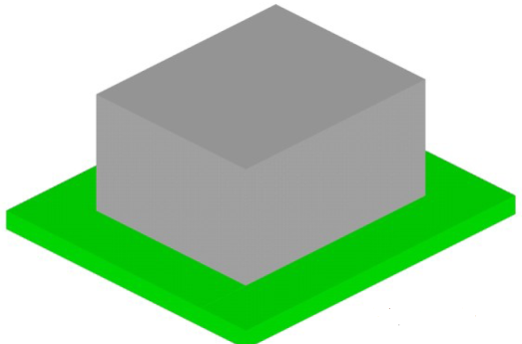
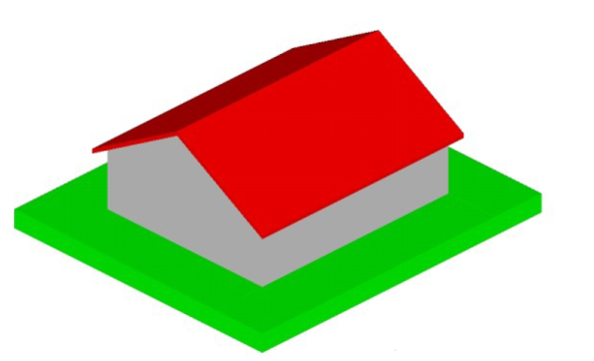
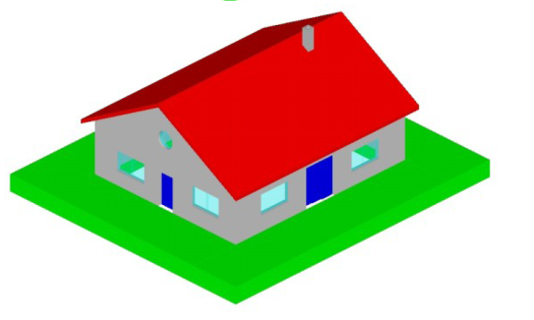
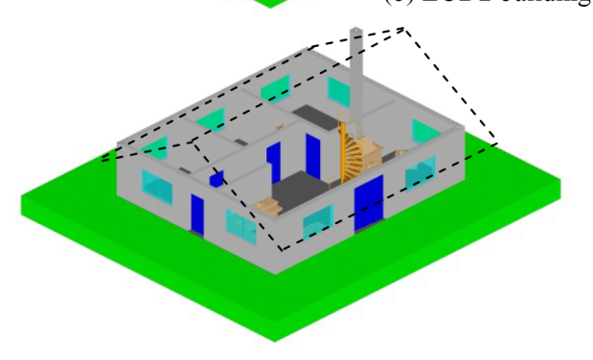
Full data model for 3D urban landscapes
Based on 3dCityDB 2.0.1
A relational implementation of CityGML 2.0
Core model, geometry representation, appearance, buildings, city furniture, land use, transportation, vegetation, water bodies …
LOD1 Building
Blocks without roof structures
LOD2 Building
Full roof structures, possibly with textures
LOD3 Building
Detailed architecture
LOD4 Building
Interior structures

Slide 101
Spatial Queries on External Tables
Spatial operations can be performed from the database using SQL
JOIN between a DB table: CINEMA and an table: TWEETS_EXT_TAB_FILE
This can be used to integrate queries between BDSG and DB tables
select ci.name, tw.user_id,
sdo_geom.SDO_DISTANCE(
ci.geometry,
SDO_GEOMETRY(tw.geometry, 4326),
0.05
) distance
from CINEMA ci, TWEETS_EXT_TAB_FILE tw
where SDO_WITHIN_DISTANCE(
ci.geometry,
SDO_GEOMETRY(tw.geometry, 4326),
'DISTANCE=0.25 UNIT=MILE'
) = 'TRUE';
select tw.user_id, ci.name,
sdo_geom.SDO_DISTANCE(
ci.geometry,
SDO_GEOMETRY(tw.geometry, 4326),
0.05
) distance
from TWEETS_EXT_TAB_FILE tw, CINEMA ci
where SDO_WITHIN_DISTANCE(
SDO_GEOMETRY(tw.geometry, 4326),
ci.geometry,
'DISTANCE=0.25 UNIT=MILE'
) = 'TRUE';

Slide 102
Resources
Oracle Spatial and Graph 12.2 Data Sheet and white papers on OTN
12.2 Documentation

